Slide 1
Chapter 7
Trigonometry / Pre-Calculus
Review Problems
Linear Systems and Matrices

Slide 2
Review Problems
Solve the system of Equations
(45, 9)
1

Slide 3
Review Problems
Solve the system of Equations
(–20, 5), (20, –5)
2

Slide 4
Review Problems
Solve the system of Equations
(3, 8)
3

Slide 5
Review Problems
Solve the system of Equations
(6, 3), (–6, 3), (6, –3), (–6, –3)
4

Slide 6
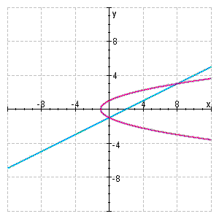
Review Problems
Two equations and their graphs are given. Find the intersection point(s) of the graphs by solving the system.
(8, 3), (0, –1)
5

Slide 7
Review Problems
Solve the system of Equations
(1, 0), (–1, 0)
6

Slide 8
Review Problems
Solve the system of Equations
7

Slide 9
Review Problems
Solve the system of Equations
(6, 3)
8

Slide 10
Review Problems
A rectangle has an area of 840 cm² and a perimeter of 122 cm. What are its dimensions?
length is 40 cm, width is 21 cm
9

Slide 11
Review Problems
Solve the system of Equations
10

Slide 12
Review Problems
Solve the system of Equations
11

Slide 13
Review Problems
Find x and y in terms of a
12

Slide 14
Review Problems
A man has 12 coins in his pocket, all of which are dimes and quarters. If the total value of his change is $2.70, how many dimes and how many quarters does he have?
2 dimes, 10 quarters
13

Slide 15
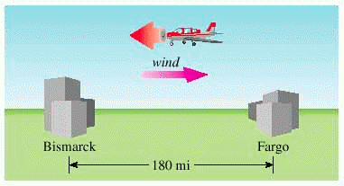
Review Problems
A man flies a small airplane from Fargo to Bismarck, North Dakota, a distance of 180 miles. Because he is flying into a headwind, the trip takes him 2 hours. On the way back, the wind is still blowing at the same speed, so the return trip takes only 1 hour 15 minutes. What is his speed in still air, and how fast is the wind blowing?
speed in still air is 117 mi/h,
the wind is blowing 27 mi/h
14

Slide 16
Review Problems
A biologist has two brine solutions, one containing 10% salt and another containing 25% salt. How many milliliters of each solution should she mix to obtain 1 L of a solution that contains 23.5% salt?
100 milliliters of the first brine solution,
900 milliliters of the second brine solution
15

Slide 17
Review Problems
Use back-substitution to solve the triangular system.
x = –3, y = 4, z = –1
16

Slide 18
Review Problems
Perform an operation on the given system that eliminates the x-term from the second equation. Write the new equivalent system.
17

Slide 19
Review Problems
Find the complete solution of the linear system, if possible.
The system is inconsistent.
18

Slide 20
Review Problems
Find the complete solution of the linear system, if possible.
x = 5t + 2, y = 2t +2, z = t
19

Slide 21
Review Problems
Write the system of equations that corresponds to the matrix.
20

Slide 22
Review Problems
Determine whether the matrices A and B are equal.
No
21

Slide 23
Review Problems
Perform the matrix operation.
The matrix operation is impossible
22

Slide 24
Review Problems
Solve the matrix equation 2X – A = B for the unknown matrix X, if
23

Slide 25
Review Problems
Find A + B if
24

Slide 26
Review Problems
Find C(AB) if
25

Slide 27
Review Problems
Find AB+AC, if
26

Slide 28
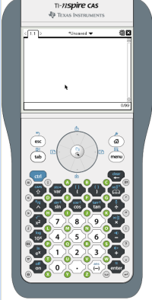
Review Problems
Find the inverse of the matrix.
27

Slide 29
Review Problems
Find the inverse of the matrix.
28

Slide 30
Review Problems
Find the inverse of the matrix.
29

Slide 31
Review Problems
Find the inverse of the matrix.
30

Slide 32
Review Problems
Solve the system of equations by converting to a matrix equation and using the inverse of the coefficient matrix
x = 10, y = -13
31

Slide 33
Review Problems
Solve the system of equations by converting to a matrix equation and using the inverse of the coefficient matrix
x = –3, y = 1
32

Slide 34
Review Problems
Solve the system of equations by converting to a matrix equation and using the inverse of the coefficient matrix
x = 1, y = -2, z = -1
33

Slide 35
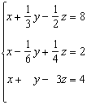
Review Problems
Use a calculator that can perform matrix operations to solve the system
x = 4, y = 24, z = 8
34

Slide 36
Review Problems
Solve the matrix equation by multiplying each side by the appropriate inverse matrix.
35

Slide 37
Review Problems
Find the inverse of the matrix.
36

Slide 38
Review Problems
Find the inverse of the matrix.
37

Slide 39
Review Problems
Find the inverse of the matrix.
38

Slide 40
Review Problems
Find the determinant of the matrix if it exists.
7
39

Slide 41
Review Problems
Find the determinant of the matrix if it exists.
52,000
40

Slide 42
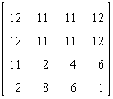
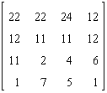
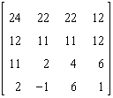
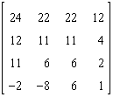
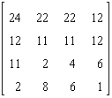
Review Problems
Identify the matrix which does not have an inverse.
41

Slide 43
Review Problems
Use Cramer's Rule to solve the system.
(42, 6)
42

Slide 44
Review Problems
Use Cramer's Rule to solve the system.
(10, 8)
43

Slide 45
Review Problems
Use Cramer's Rule to solve the system.
x = 9, y = 1, z = –21
44

Slide 46
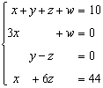
Review Problems
Use Cramer's Rule to solve the system.
x = 2, y = 7, z = 7, w –6
45

Slide 47
Review Problems
Use a determinant to find the area of triangle with the given vertices.
(–1, 3), (2, 7), (5, –6)
46

Slide 48
Review Problems
Write the form of the partial fraction decomposition of the function. Do not determine the numerical values of the coefficients.
47

Slide 49
Review Problems
Write the form of the partial fraction decomposition of the function. Do not determine the numerical values of the coefficients.
48

Slide 50
Review Problems
Write the form of the partial fraction decomposition of the function. Do not determine the numerical values of the coefficients.
49

Slide 51
Review Problems
Write the form of the partial fraction decomposition of the function. Do not determine the numerical values of the coefficients.
50

Slide 52
Review Problems
Write the form of the partial fraction decomposition of the function. Do not determine the numerical values of the coefficients.
51

Slide 53
Review Problems
Write the form of the partial fraction decomposition of the function. Do not determine the numerical values of the coefficients.
52

Slide 54
Review Problems
Find the partial fraction decomposition of the rational function.
53

Slide 55
Review Problems
Find the partial fraction decomposition of the rational function.
54

Slide 56
Review Problems
Find the partial fraction decomposition of the rational function.
55

Slide 57
Review Problems
Find the partial fraction decomposition of the rational function.
56

Slide 58
Review Problems
Find the partial fraction decomposition of the rational function.
57

Slide 59
Review Problems
Find the partial fraction decomposition of the rational function.
58

Slide 60
Review Problems
Find the partial fraction decomposition of the rational function.
59

Slide 61
Review Problems
Find the partial fraction decomposition of the rational function.
60

Slide 62
Review Problems
61

Slide 63
Review Problems
62

Slide 64
Review Problems
63

Slide 65
Review Problems
64

Slide 66
Review Problems
65

Slide 67
Review Problems
66

Slide 68
Review Problems
67

Slide 69
Review Problems
68

Slide 70
Review Problems
69

Slide 71
Review Problems
(45, 9)
18.
19.
(–20, 5), (20, –5)
(3, 8)
2 dimes, 10 quarters
(6, 3), (–6, 3), (6, –3), (–6, –3)
speed in still air is 117 mi/h,
the wind is blowing 27 mi/h
(8, 3), (0, –1)
100 milliliters of the first brine solution,
900 milliliters of the second brine solution
(1, 0), (–1, 0)
x = –3, y = 4, z = –1
(6, 3)
length is 40 cm, width is 21 cm
The system is inconsistent.
x = 5t + 2, y = 2t +2, z = t

Slide 72
Review Problems
No
x = 10, y = -13
The matrix operation is impossible
x = –3, y = 1
x = 1, y = -2, z = -1
x = 4, y = 24, z = 8
7

Slide 73
Review Problems
52,000
A
(42, 6)
(10, 8)
x = 9, y = 1, z = –21
x = 2, y = 7, z = 7, w –6

Slide 74
Review Problems

Slide 75
Thanks to MrFrontius.com!

