Slide 1
Degree and Radian Angle Measures
Mr. Perone

Slide 2
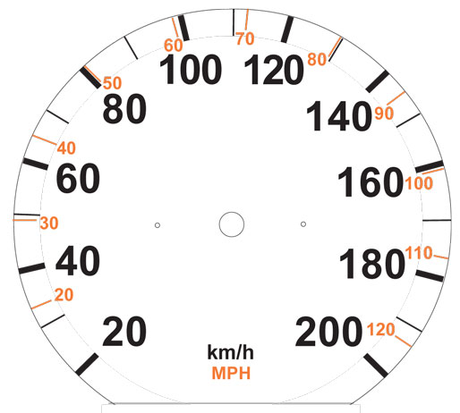

Slide 3
II
I
0°
180°
III
IV

Slide 4
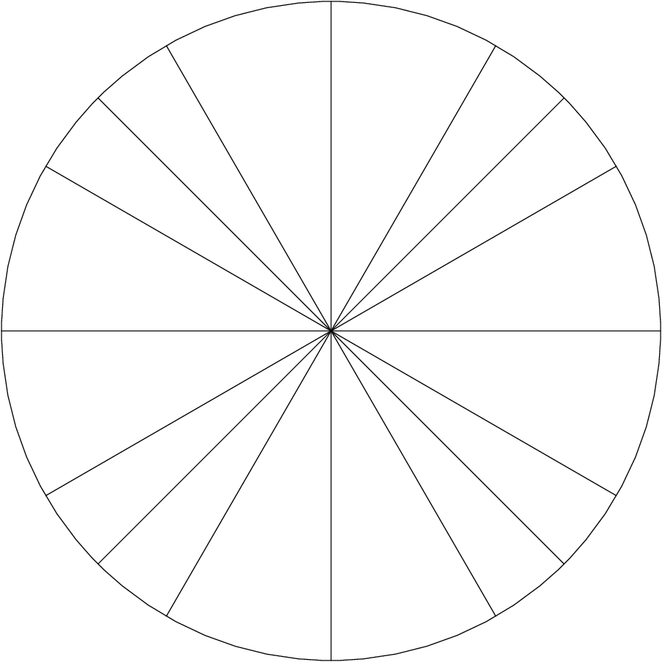
π
0 or 2π

